Slide 1
Review
Basic 1

Slide 2
A:______________________
B:My name is Giannina Zavala.
What your name?
What's your name?
Is your name Giannina?
What is name?

Slide 3
A:____________________
B:Yes, it is.
Are your nickname Gianni?
Is nickname Gianni?
What's your nickname?
Is Gianni your nickname?

Slide 4
3.A:________________________
B:No, he isn't. My teacher is Mr. Zegarra.
Is Mr. Smith your teacher?
Mr. Smith your teacher?
Is Mr. Doe your teacher?
Is Mr. Smith teacher?

Slide 5
A:__________________________
B:Yes, she is. She's a great singer
Rihanna is a singer?
Rihanna a singer?
Is Rihanna a singer?
Is Rihanna singer?

Slide 6
5.A:______________________
B: My first name is James.
Is first name James?
Is your first name James?
First name James?
What's your first name?

Slide 7
6.A: ________________________
B:No, it isn't. It's Jimmy.
Is your last name Jimmy?
Is Johnny you´re nickname?
Is Johnny your nickname?
What's your nickname?

Slide 8
7.A:_____________________
B:It's old and boring.
What's your hometown like?
Is your hometown old and boring?
What hometown like?
What's hometown?

Slide 9
8. A:_____________
B: She's from Tokyo.
Where Sachiko from?
Who is Sachiko?
Where is Sachiko from?
Where is Sachiko?

Slide 10
9.A:__________________
B: It's beautiful and clean.
Where is Paris?
What is Paris like?
What is Paris?
What Paris like?

Slide 11
10.A:____________________
B: Yes, it is big and modern.
What is Miami like?
Miami is big and modern?
Is Miami big and modern?
Miami is big and modern?

Slide 12
11.A:____________________
B:No, he isn't. He's from Paris.
Is Pierre from Miami?
Where is Pierre from?
Pierre from Miami?
Where from is Pierre?

Slide 13
12.A:____________________
B:I am from Peru.
Is you from Peru?
Where are you from?
Where my from is Peru?
Where your from is?

Slide 14
1. What´s your name?
2. What´s your nickname?
3. Are you from China?
4. Is your brother at ICPNA?
5. What is your favorite movie?
6. Who is your favorite singer?

Slide 15
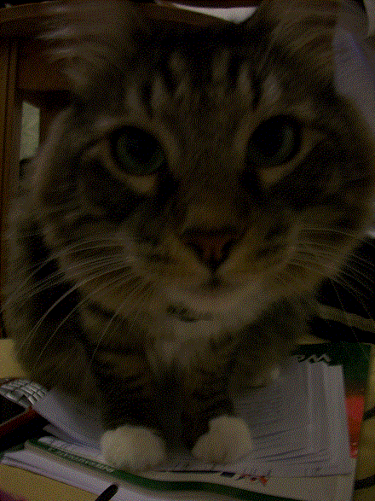
6. Are you a writer?
7. Is this a cat?
8. Is Tongo your favorite singer?
9. Is your brother in Basic 1?
10. Is the camera expensive?

Slide 16
11. Where are you from?
12. What is your city like?
13. Where is ICPNA?
14. Who is your favorite singer?
15.Where are you?
16.Who is your teacher?

Slide 17
Correct the mistakes
My from is Peru.
I am from Peru.
He´s name is Cristian.
His name is Cristian.
These are a new cell phones.
These are new cell phones.
I student ICPNA
I am a student at ICPNA
My mom is in the library. This is she´s key
My mom is in the library. This is her key.

Slide 18
Correct the mistakes
I am from Peruvian
I am Peruvian
Those is ugly pencils
Those are ugly pencils
She´s best friend is Nancy.
Her bestfriend is Nancy.
What is your teacher?
Who is your teacher?
My cellphone is an old.
My cell phone is old.

